Slide 1
Starter:
Kahoot

Slide 2

Blue Monday
We’ve been asked to support the Blue Monday activities, and I’ve said that our class will attend the 9.45 am Yoga/Meditative Movement session with Darryl in G.16 as a group.
Here’s what else is happening throughout the morning:
10.15 am: Psychology/Health Student Information
11.00 am: Yoga/Meditative Movement (repeat session)
From 11.30 am: Y3 Sport students sharing research on Physical Activity (PA) & Mental Health (MH)
All morning: Resource display by Health students, plus insights from the Welfare team and CUSU New Manager Catherine.

Slide 3
Introduction to Functions
Understanding, Writing, and Implementing Functions in Programming

Slide 4
Objectives
- Understand the concept and purpose of functions.
- Write simple functions and use return values.
- Create multi-return functions.
- Implement multiple functions in a program.

Slide 5
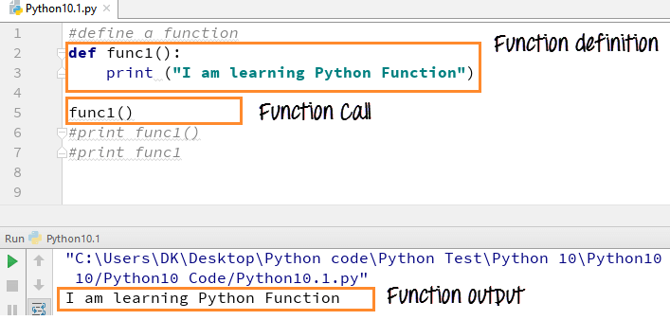
Functions Introduction
What is a Function?
- A reusable block of code that performs a specific task.

Slide 6
- How Functions help:
- Simplify code (modularity).
- Reuse code (efficiency).
- Debug easily (isolation).

Slide 7
Practice:
Task Overview:
Write a function that takes a number as input and returns double its value.
Example Input/Output:
Input: 5
Output: 10

Slide 8
Step 1:
Plan Your Function
Discuss with your group and plan the following:
- What will the function name be?
- What will the input be?
- What will the function return?

Slide 9
Step 1: Ideas
What will the function name be?
Example Answer: double_number
What will the input be?
Example Answer: A single number (e.g., 5).
What will the function return?
Example Answer: Double the input (e.g., 10).

Slide 10
Step 2: Plan and Write the Function (10 minutes)
Input:
The function should accept one input: a number (e.g., 5, -3, or 2.5).
Think about the type of input—use numbers (integer or float).
Output:
The function should return the input multiplied by 2.
Use the return keyword to send the result back.

Slide 11
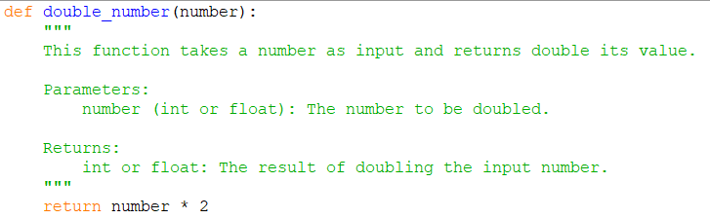
1st Part
Function Definition:
def double_number(number):
This line defines a function named double_number, which takes one input, called number.
The lines between the triple double quotes (""") explain what the function does:
return number*2
This calculates the result of multiplying number by 2.It then sends (or "returns") that result back to wherever the function was called.

Slide 12
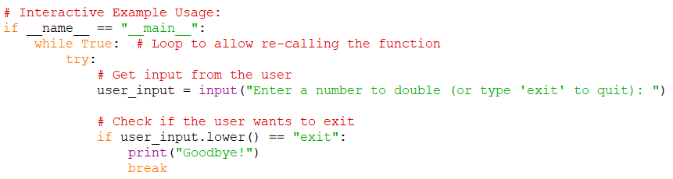
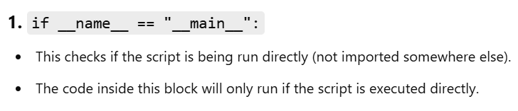
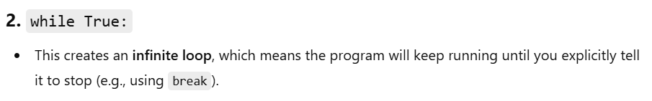
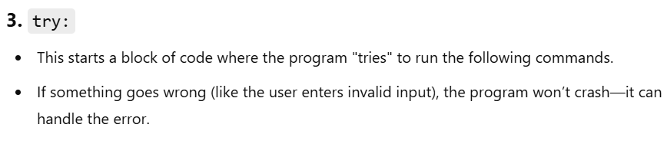
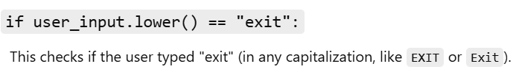

Slide 13
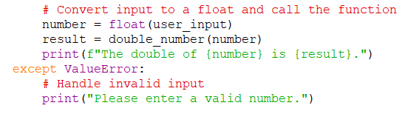
number = float(user_input)
This converts the user's input (which is a string) into a floating-point number.
result = double_number(number)
This calls the double_number function (defined earlier)
print(f"The double of {number} is {result}.")
This prints the result in a friendly way using an f-string. (An f-string lets you put variables or math directly inside a sentence by using {}. It's an easy way to create sentences with values included.)
except ValueError:
If the user enters something that cannot be converted to a number (like "abc" or "hello"), the float(user_input) line will cause an error. This except block catches that error and prevents the program from crashing.

Slide 14
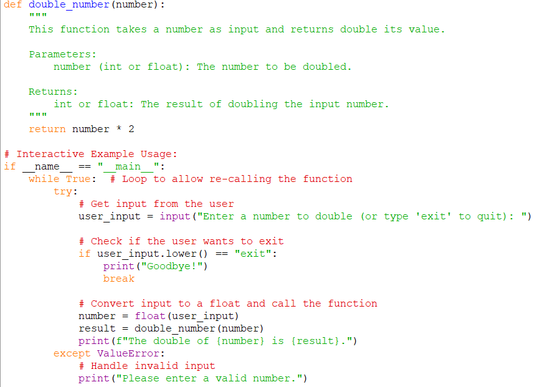

Slide 15
Extension Task:
Task: Create a function called create_greeting that takes a name as input and returns a personalised greeting.
If a name is given, return: "Hello, [name]!".
If no name is provided, return: "Hello, Stranger!".
Example:
Input: "Alice" → Output: "Hello, Alice!“
Input: "" → Output: "Hello, Stranger!“
Extra Challenge: Add another message to the greeting, like: "Have a great day!".

Slide 16
Break
- Take a 30-minute break.
- Stretch, grab a coffee, and prepare for the next session!

Slide 17
Labs – Functions Worksheet

